Slide 1
User interface design

Slide 2
UI: Week 6, Friday
Dr. Jillian Aurisano
Plan for today:
Announcements/Course logistics
Observation
Practice observing
Notes:
So welcome to engineering visual interfaces for data science. I'm Dr Aurisano.
Thanks for finding the class on Zoom. Hopefully we will be in person again soon.
If anyone out there is comfortable turning on their cameras, that is lovely- then I feel like I am talking to students, rather than to myself.
Here’s our plan for today:
First I’m going to introduce myself, so you know a bit about me
Then we are going to get to know each other, in Zoom breakout rooms. This will give us a chance to make sure that Zoom breakout rooms work, and we all know how to access them.
Then, I am going to walk through the structure, and plan for the course. I want to make sure everyone knows how the course will work, and what to expect, and also a bit about why the course is designed this way.
Then I am going to introduce the class, and what the class is about. Since this is a new class, and one of just a few classes in human centered computing here at UC, I wanted to give an overview of the topic.
Then I have an introductory activity, which we will do in breakout rooms, and which I think will help motivate the discussion on Wednesday, and getting into the meat of the class.

Slide 3
Project 2- How’s it going?
SvelteKit- not necessary, but just make sure your team does the tutorial on SvelteDev
What is sveltekit-
Routing- when you have multiple pages – helpful
Efficiency additions
General reminders- no need for a db, no need for a server. Use flat files (json) or arrays of data. No need for actual AI.
Take a look at the options at higher levels- every year I get questions.

Slide 4
Qualitative vs Quantitative methods in human-centered computing
Qualitative methods: Capture qualitative data (text descriptions, images…). Materials that can’t be summarized with statistics
Quantitative methods: Capture data that can be analyzed with statistics or graphed
Is one better than the other?

Slide 5
Today: let’s talk about observation
Observation is a key tool in UI/UX research
We can all observe things, but let’s talk about how to use observation to inform UI/UX design

Slide 6
Observation context
Observation in a laboratory setting
Allows you to design the protocol and context
Reduces variables- every participant has the same context
Control over realism
Easier to replicate
Can control external variables
Observation ‘in the wild’
Observing how someone works or uses a product in a real world setting- in their office, in their home, when they are traveling…
It is less controlled- you can’t ensure that every participant in your study has the same environment and protocol
But more realism- closer to how the tool might actually be used

Slide 7
Protocol
You may give the user a task to perform (more often in laboratory setting)
Ex. Analyze this data using this tool. Explore the data freely, and write up a set of observations that we will use later for analysis.
Ex. Create a schedule for your organization for the week, based on these constraints that we are giving you, using this tool.
OR you may watch them work in a natural setting
Ex. Show me how you use data analysis tools for a current project.
Ex. Walk me through a scheduling task you recently performed

Slide 8
Process
Typically, you record the observational session and analyze using a coding scheme (labels on behaviors and actions)
Examples:
Yes/No did the participant accomplish task X
How many applications did the participant in the study use to create the schedule?
Noting all instances where they used paper notes
Sometimes you have already developed this coding scheme, if you know what you are wanting to measure
Other times, you develop the coding scheme around what participants in your study do
Why? Isn’t this un-scientific?

Slide 9
Grounded theory
Methodology in qualitative research developed by sociologists, recorded in a book Discovery of Grounded Theory (1967)
Begins with high level questions and data (such as video recordings and transcripts from an observational study)
Review the data to see how ideas and concepts ‘emerge’
You tag these concepts with codes that capture or summarize these ideas and concepts

Slide 10
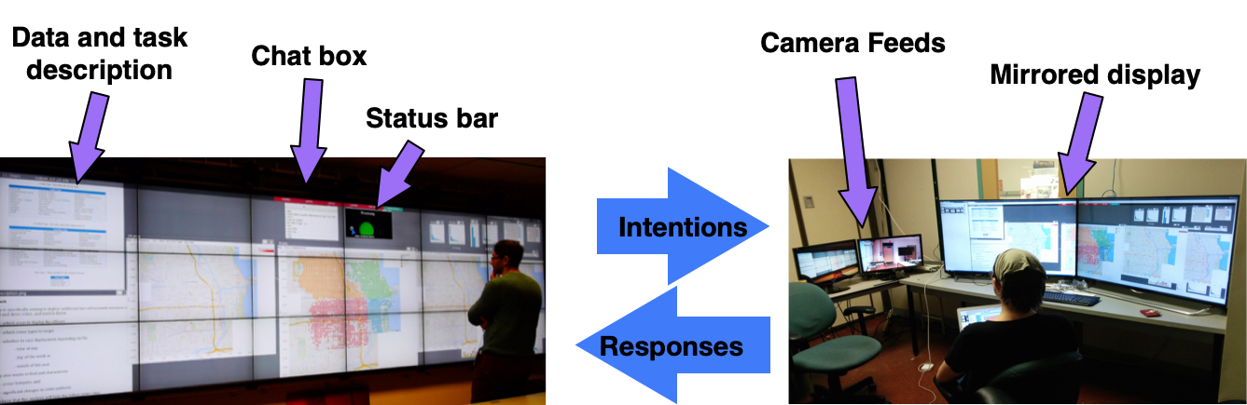
A study I did…
I noticed that they were referencing visualizations to ask questions, and referencing multiple visualizations to ask questions.
This concept ‘emerged’ from my observations of their behavior, reviewing the video and transcripts
Then, I developed a set of codes ‘did they reference visualizations in their question?’ ‘how many visualizations did they reference’

Slide 11
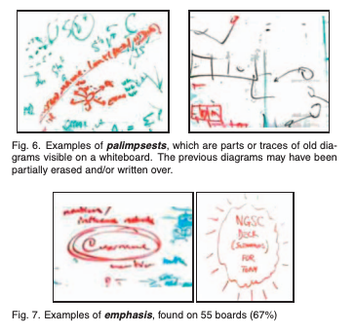
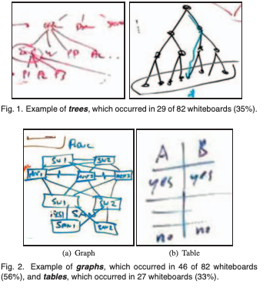
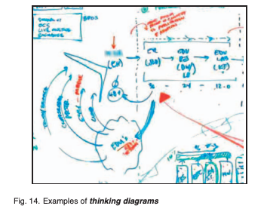
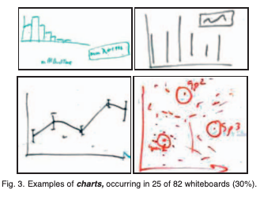
A fabulous observational study
How do people sketch on whiteboards?
How could we design sketch interactions
https://ieeexplore.ieee.org/stamp/stamp.jsp?tp=&arnumber=6065018

Slide 12
How do parents use tech on the playground?
“Over three months, researchers individually visited seven playgrounds in north Seattle. Site visits were spread over all days of the week between 8 a.m. and 7 p.m. Across 22 visits we collected a total of 33 hours of observational data. Because we could not always observe all individuals simultaneously, researchers chose a subset of caregivers to observe based on their location within the playground and their arrival time. Once the researcher began observing a caregiver, she continued observing him or her until the caregiver left the playground. We documented field data in jottings which were later used to develop ethnographic fieldnotes [8]."

Slide 13
How to really see
What are users actually doing, as opposed to what you expect them to be doing
Move between
Focus on details, not just broad general behaviors
But also look at the whole context- how does this product fit in with the flow of someone’s work or life?

Slide 14
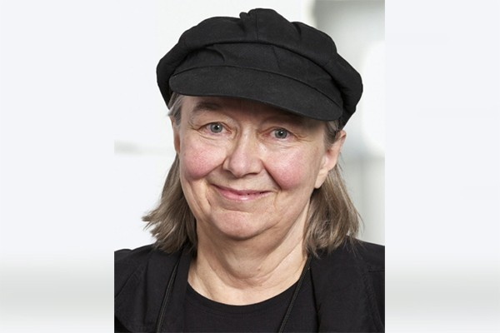
Today we are going to use a real observational study in class
Sheelagh Carpendale
Trained as an artist whose research is in CS
(she wrote the sketching book I use in class)
She gave a lecture on observational studies and described this experiment

Slide 15
Touch tables for collaborative work
She wanted to understand how to design interfaces and interactions for large touch tables to support collaborative work
How to help people accomplish tasks, and work together, if they are working on a large touch table
She and her grad students said ”What do people do on tables together?”
Puzzles!
Ok, so let’s record people doing physical puzzles on a table together
Can we learn something that will help us design real interactions and UI elements on a touch table for multiple uers?

Slide 16
Let’s do it!
Divide the class into 2 groups
3 volunteers from each group will do the puzzle together
The rest, get out some paper, and let’s observe how they
Use the table space to organize their work
How they coordinate with each other
How they ‘interact’ – use their hands and movements of pieces
How they move through space
Other interesting notions that arise from observing!
Observe for 7 min, discuss how we would ‘code’ their behaviors, watch them and make note of these behaviors
What can we learn?

Slide 17
What did you observe?

Slide 18
How did Sheelagh analyze the data?
Story…

Slide 19
Some papers
https://www.researchgate.net/figure/The-geometric-puzzle-electronic-version_fig7_220169131
https://innovis.cpsc.ucalgary.ca/innovis/uploads/Publications/Publications/ExploringTabletopInteraction2004.pdf

